Slide 1
WELCOME

Slide 2

TITLE
OLA Rides

Slide 3
Introduction
What is this about?
This presentation covers analysis of four ride types using dashboard data. We look at booking trends, customer feedback, and operational challenges to suggest improvement strategies
It shows data from different ride types.
Helps to understand how many bookings were made, revenue, toll, ratings, etc.
Useful for making business decisions.

Slide 4
Objectives
Understand revenue and rating performance
Identify operational inefficiencies
Recommend solutions based on data

Slide 5
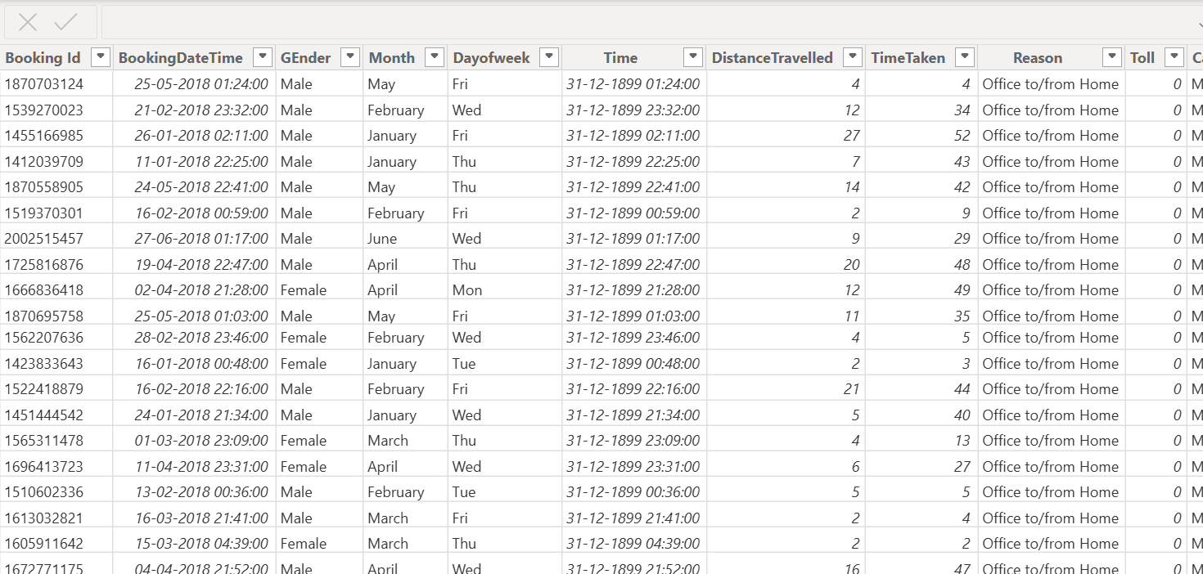
Data Set Before Cleaning

Slide 6
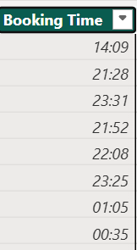
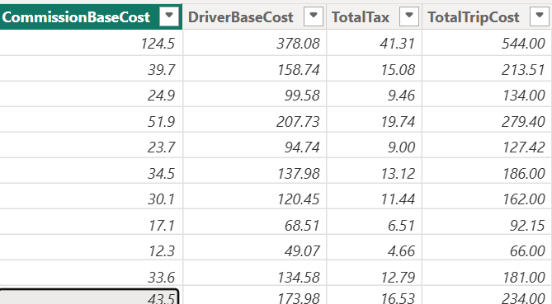
Step used for data cleaning
1. It was in a long date-time format, but I converted it to a short time format.
2. The decimal was converted to a whole number as the amount should not be in decimal format

Slide 7
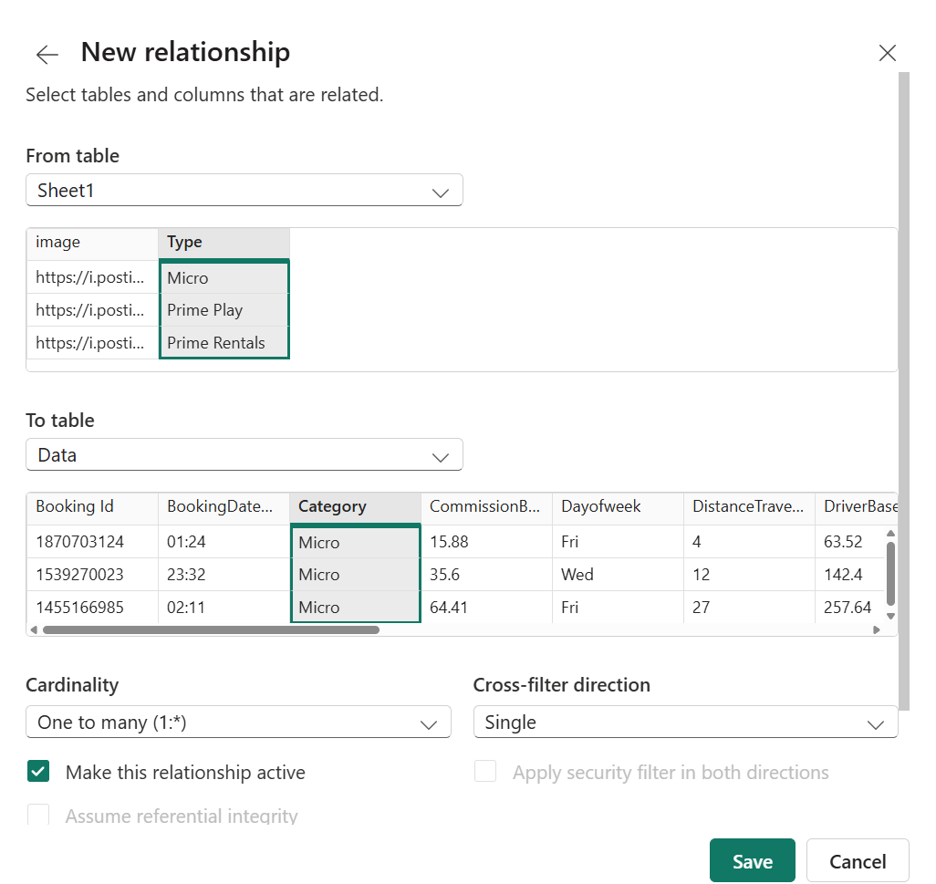
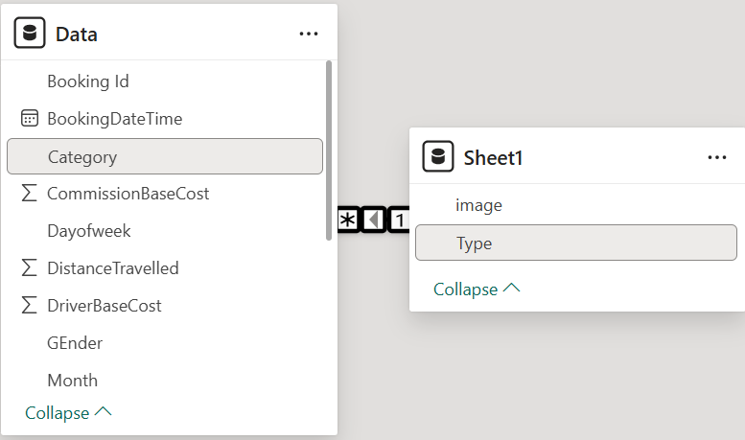
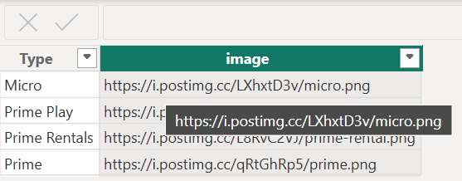
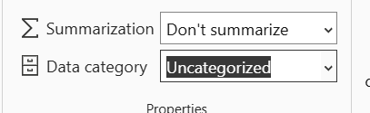
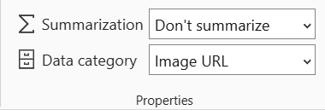
3. Create a one-to-many relationship between car type and category.
5. It was in an uncategorized format, and I converted it into image URLs using the properties format table in data Category to generate images in dataset.

Slide 8
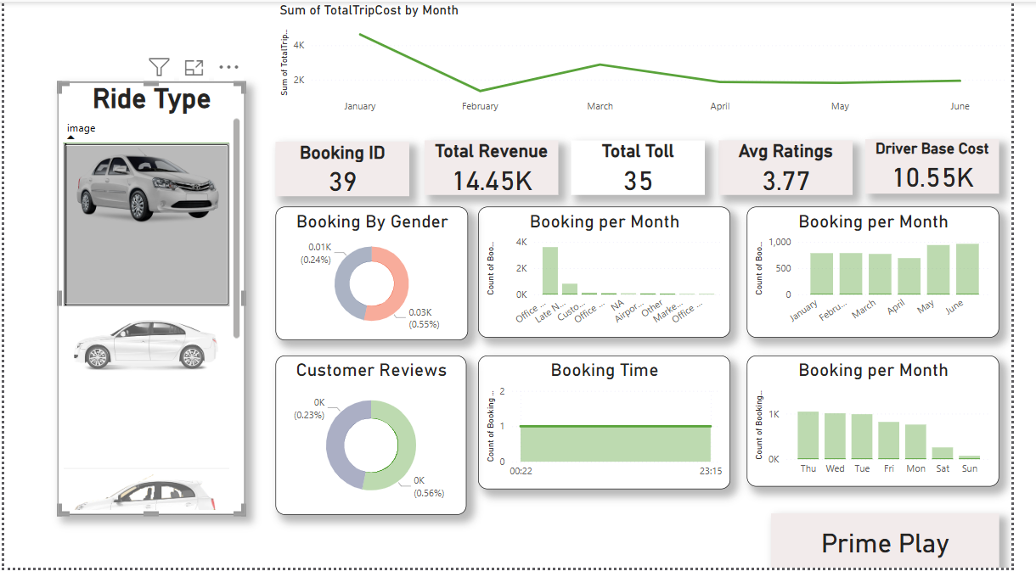
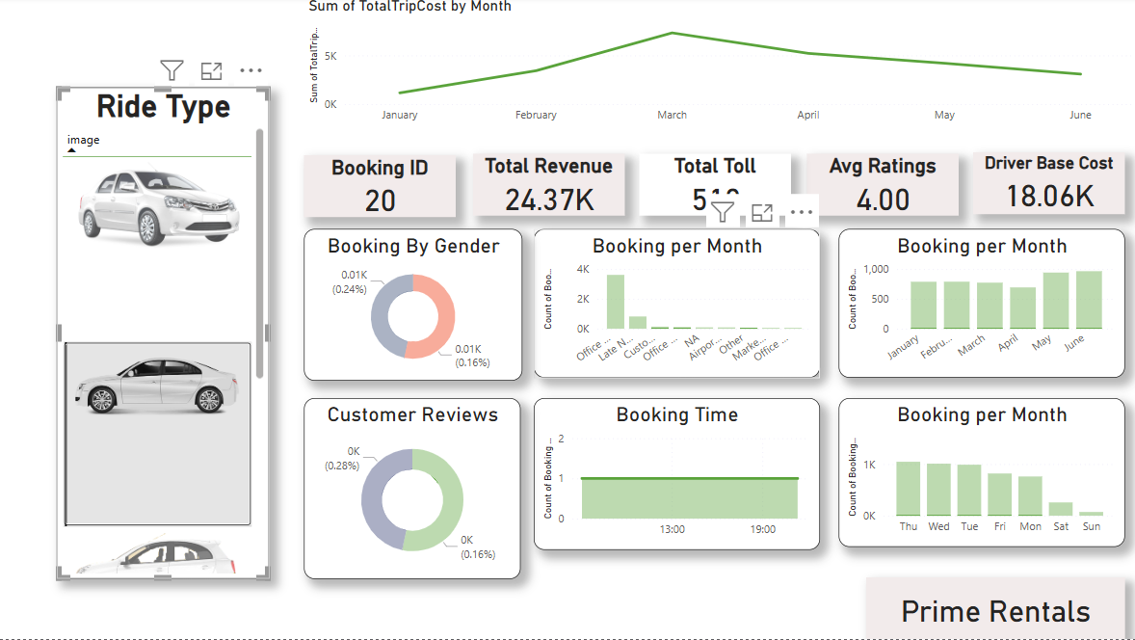
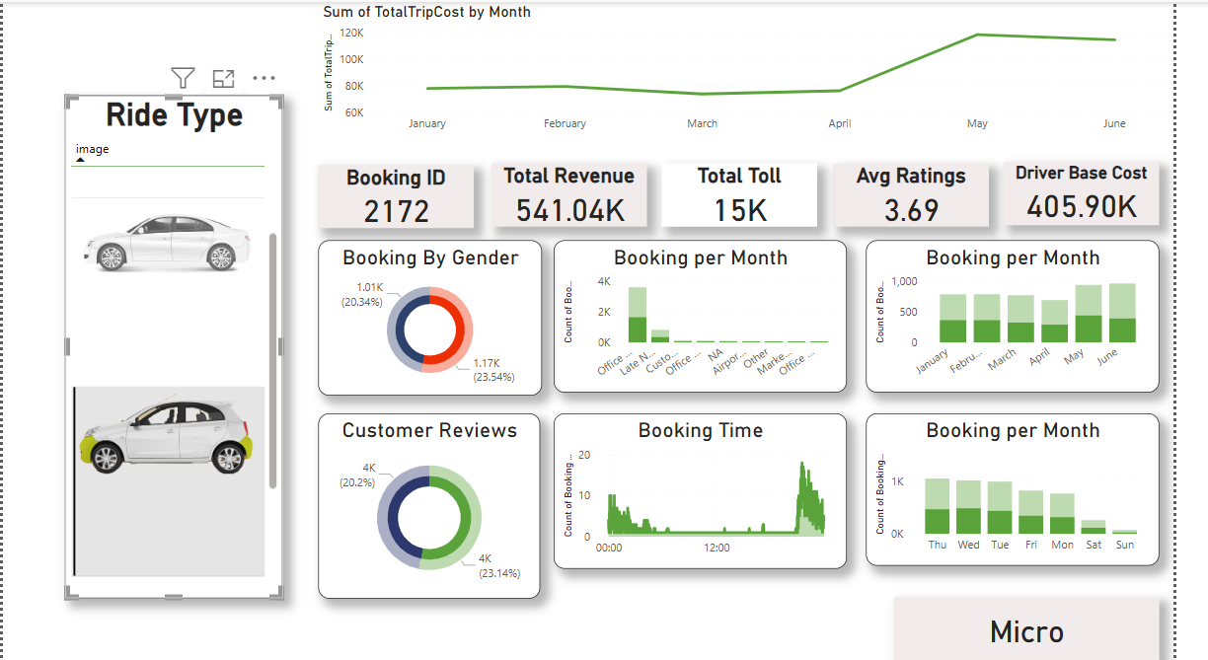
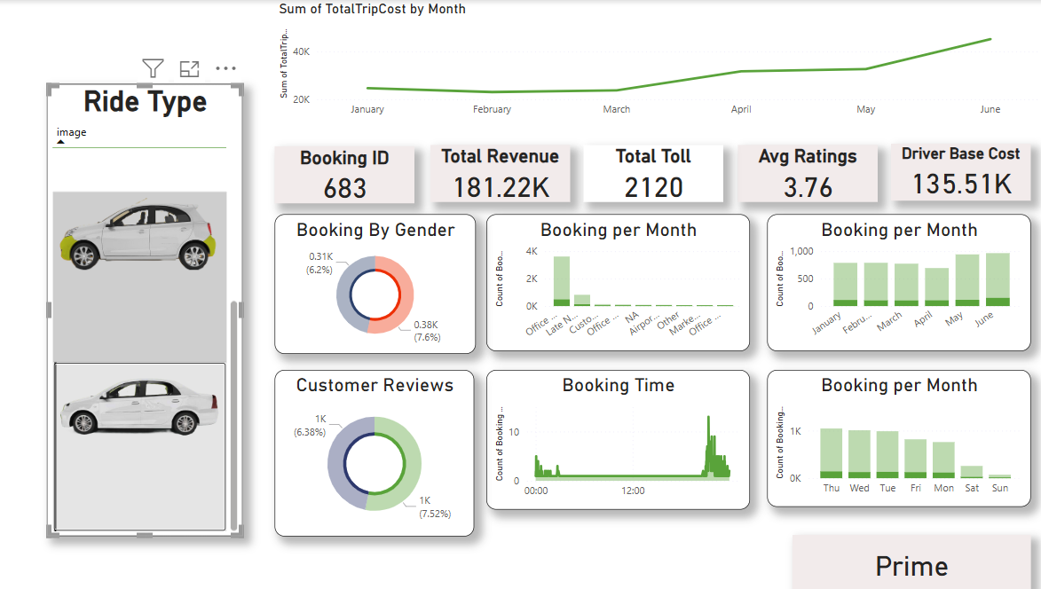

Slide 9
KEY INSIGHTS
Micro ride type performs the best in bookings and revenue.
Prime Play and Prime Rentals are underperforming significantly.
Customer reviews and gender-based booking trends show similar engagement but lower volumes in underperforming segments.

Slide 10
❗ PROBLEMS IDENTIFIED
Problem | Description
1. 📉 Low Bookings in Prime Play & Prime Rentals | Very low booking count (only 39 & 20) compared to Micro (2,172).
2. 💸 High Driver Base Cost with Low Revenue | Prime Play & Rentals have poor cost efficiency.
3. ⏰ Uneven Booking Times | Prime Play mostly booked at night, others lack peak-hour coverage.
4. 🗣️ Low Customer Reviews | Reviews are low across all ride types, indicating poor feedback collection.
5. . 🧾 High Toll in Low Revenue Categories | Some ride types have tolls but don’t generate enough revenue to cover them.
.

Slide 11
✅ WHAT STEPS SHOULD BE TAKEN TO FIND THE SOLUTION
Step | Action
1. 🔍 Analyse Booking Trends | Compare date, time, and ride type data to see when and why users book less for Prime Play & Rentals.
2. 📣 Run Targeted Promotions | Offer discounts, cashback, or bundle offers to increase awareness and demand for underused ride types.
3. 👨‍✈️ Optimize Driver Allocation | Shift drivers from low-demand (Prime Play) to high-demand rides (Micro) to reduce cost waste.
4. 📆 Expand Time Slots | Make low-performing rides available during peak hours to match user demand.
5. 📲 Encourage More Reviews | Use in-app prompts or reward points after rides to boost customer feedback.
6. .🛣️ Check Route Efficiency | Review long routes or high-toll rides for alternatives that save cost.

